Slide 1
Doctor-Office Collaborative Care: A Team Approach to Treating ADHD in Primary Care
October 13, 2016 | 12:00-2:00 p.m.

Slide 2
Agenda
Project overview
Provider presentations
Review
Question and Answers

Slide 3
About Community Care
Behavioral health managed care company founded in 1996; part of UPMC and headquartered in Pittsburgh
Federally tax exempt nonprofit 501(c)(3)
Major focus is publicly-funded behavioral health care services; currently doing business in PA and NY
Licensed as a Risk-Assuming PPO in PA; NCQA- Accredited Quality Program
Serving approximately 950,000 individuals receiving Medical Assistance in 39 counties through a statewide network of over 1,800 providers

Slide 4
HealthChoices Regions Served
Erie
Warren
McKean
Potter
Tioga
Bradford
Susquehanna
Crawford
Wayne
Forest
Cameron
Wyoming
Venango
Elk
Sullivan
Lackawanna
Pike
Mercer
Lycoming
Pike
Jefferson
Clinton
Luzerne
Clarion
Columbia
Monroe
Lawrence
Clearfield
Centre
Union
Montour
Butler
Carbon
Armstrong
Snyder
Northumberland
Northampton
Beaver
Indiana
Mifflin
Schuylkill
Lehigh
Allegheny
Juniata
Blair
Perry
Dauphin
Berks
Bucks
Cambria
Huntingdon
Lebanon
Westmoreland
Montgomery
Washington
Cumberland
Lancaster
Fayette
Bedford
Chester
Greene
Somerset
Fulton
Franklin
Adams
York
Philadelphia
Delaware
Southwest Region
Southeast Region
North Central Region: County
Lehigh-Capital Region
North Central Region: County
North Central Region: County
Northeast Region
North Central Region: County
North Central Region: State
Community Care Office

Slide 5
Health Care Coordination
Efforts to improve overall wellness through integrated physical and behavioral health care
Responsive to calls for coordinated care (Affordable Care Act)
Enhance capacity of behavioral health providers to empower individuals to manage physical wellness
Improve assessment and treatment of behavioral health disorders in primary care

Slide 6
DOCC Model
Integrated behavioral health treatment in primary care
Psychiatric consultation
Collaborative health care team
May result in improved behavioral health service utilization compared to non-integrated models

Slide 8
Pediatric FQHC LC
Six providers
Six month participation and commitment
Oversight and support from Community Care
Hint: Set a firm time frame to start and end the measurement period of the learning collaborative

Slide 9
What is a learning collaborative?
Structured approach for change
Adopt best practices in multiple settings
Uses adult learning principles & techniques
Time-limited learning process
Shared learning & collaboration

Slide 10
The Breakthrough Series
For articles and information about the learning collaborative model and quality improvement efforts, visit http://www.ihi.org

Slide 11
Why use the IHI model?
Proven quality improvement record
Supports skill development of clinical home staff
Promotes mutual learning among participants
Increases use of data to inform decisions and practice
Develops infrastructure to sustain improvement
Spreads new knowledge and improvement to other parts of organization

Slide 12
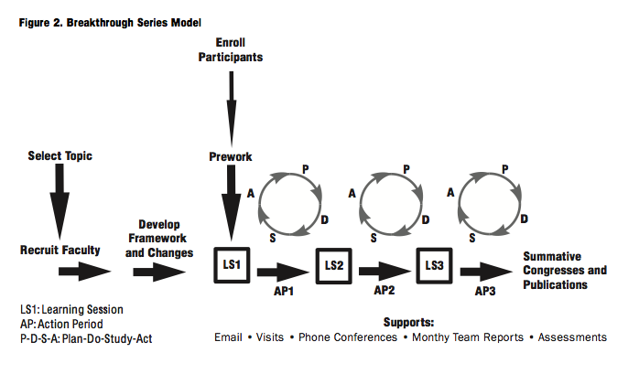
IHI Model and Structure
Hint: Break the quality improvement effort into smaller cycles of measurable change

Slide 13
Learning Collaborative Personnel
Quality Improvement Team (QIT)
Upper level administrator
Clinical supervisor
Quality assurance
Patient representative and families
Consulting psychiatrist
Champion

Slide 14
Learning Collaborative Milestones
Staff | Milestone 1: Lay the Foundation | Date
 | Have you reviewed and signed the learning collaborative charter?
 | Discuss the charter and purpose of the project with key leadership
 | Discuss the charter and purpose of the project with key providers
 | Have you established a Quality Improvement Team (QIT) for this initiative?
 | Executive Leadership
 | Clinical/Quality Improvement Leadership
 | Behavioral Health Provider
 | Pediatrician
 | Psychiatric Consultant
 | Health Center patient/family member
 | Other?
 | Have you developed a schedule for regular meetings of the QIT? When will the QIT meet?
 | Inform your Community Care Facilitator of meeting dates and times
 | Have you developed a list of topics to guide PDSAs for this initiative?

Slide 15
Learning Collaborative Process Aims
Process Aim: Identification
Screen and identify youth with ADHD
Process Aim: Treatment
Link youth with ADHD and families to behavioral health treatment (ex, SKIP)
Hint: The Process Aim helps you monitor an activity important in the delivery of the new or improved practice

Slide 16
Process Aim
 | June | July | August
Number of youth seen at the center (optional): | 250 | 261 | 240
Number of completed Vanderbilts (optional): | 39 | 25 | 40
Number of youth identified with ADHD: | 7 | 10 | 9
Number of youth with ADHD (above) seen by the BHP: | 4 | 5 | 7

Slide 17
Process Aim
Hint: Display data in tables and graphs to make change over time easier to observe

Slide 18
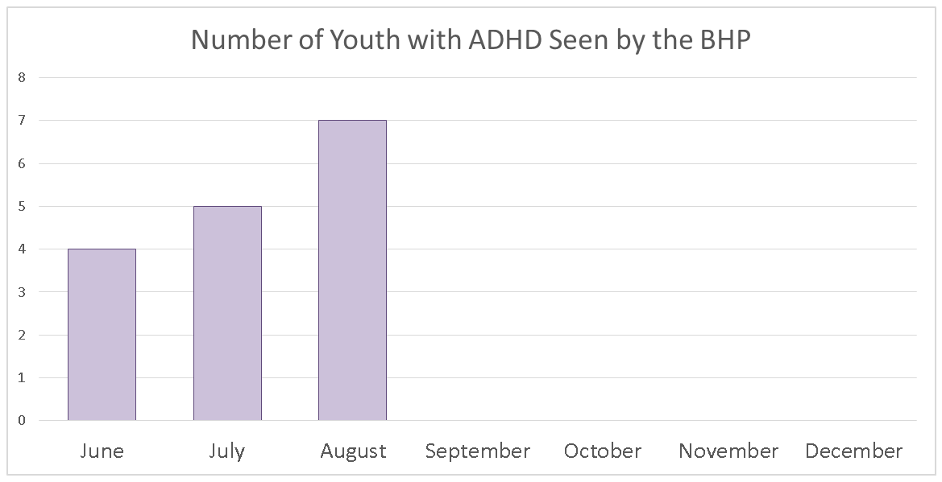
Process Aim

Slide 19
Learning Collaborative Outcome Aim
Outcome Aim: ADHD Improvement
By December 31, 2016, 60% of youth with a Vanderbilt score indicating ADHD will show improvement
Hint: The Outcome Aim helps you monitor the impact of the new or improved practice on individuals

Slide 20
Outcome Aim Defined
 | First Vanderbilt |  |  |  | Second Vanderbilt
 |  |  | Inattention (1-9) | Hyperactivity (10-18) |  | Inattention (1-9) | Hyperactivity (10-18)
ID (non-PHI) | Outcome of 1st Vanderbilt | Date of 1st Vanderbilt | # items scored 2 or 3 | # items scored 2 or 3 | Date of 2nd Vanderbilt | # items scored 2 or 3 | # items scored 2 or 3

Slide 21
What next?
Establish a process for continuous quality improvement
Use information
Milestone completion, process and outcome aims
Implement a quality improvement activity
Seek out feedback and support
QIT
Monthly regional support calls
Learning sessions

Slide 22
Quality Improvement Cycle: PDSA
Plan
Do
Study
Act

Slide 23
PDSA Cycle
Small tests of change
Conduct one or more each month
Measure impact of small test of change
Review data
Share progress with the collaborative
Act on results
Hint: Make your PDSA small and focused; have a measurable objective

Slide 24
PDSA Worksheet
PDSA Cycle June
BEGIN DATE: |  |  |  | DATE :
Milestone/Fidelity:
PLAN
What is your objective?
What question(s) do you want to answer on this PDSA cycle?
What do you predict will happen?
DO
Did you carry out your plan? | □ | Yes |  | □ | No
Summarize what happened.

Slide 25
Learning From Others
Monthly webinar support sessions
Discussion of aims, milestones, progress, challenges, successes
Quarterly in person meetings and assistance
Storyboard presentations
Hint: Provide an opportunity for participants to share an overall experience

Slide 26
Pediatric Learning Collaborative
River Valley Health and Dental Center

Slide 27
About RVH&DC
Became an FQHC in 2012
85 employees total
10,030 total patients and 1,502 pediatric medical patients
Services offered:
Medical
Health education
Dental
Urgent care
Behavioral health

Slide 28
Pediatric Behavioral Health Flow
Brief Intervention
Parent expresses concerns to provider during visit and provider or BHC gives parent the Vanderbilt to complete and instructions on follow up.
SKIP
Once the child has been diagnosed with ADHD (any type) and there are little or no mood disruptions indicated, BHC schedules appointment to start SKIP.
Weekly or bi-weekly appointments scheduled around school/sport/guardian schedules to meet with both patient and parent for 20-30 minutes each.
Progress monitored with guardian feedback and follow up Vanderbilt screenings.
Type of services available to child is also discussed as well as obtaining appropriate releases to exchange information with schools/day cares.

Slide 29
What’s next?
Hiring more staff!
RVH&DC providers value to accessibility of BHC
Looking for 5:1 ratio
First SKIP case was successful!
6 yr old male started medication and family implemented skills taught during intervention
Will come in for bi-monthly medication checks

Slide 30
Pediatric Integrated Care
Family First Health

Slide 31
What, Why, and How
What: LC guided by Community Care; 6 mo. duration; collaboration with 5 other organizations
Berks Community Health Center (FQHC – Reading), JC Blair Hospital (Huntington), NEPA Community Health Care (FQHC – Scranton), River Valley Health & Dental Center (FQHC – Williamsport), The Wright Center Medical Residency & Primary Care
Why: Gap: 6 -9% school aged children meet criteria for ADHD; most initially diagnosed & treated by PCP; greater coordination of care & improved outcomes when BH intervention is offered
How: doctor office collaborative care/SKIP; evidence-based psychosocial care; 565 children, 92 PCPs, 12 practices, 8 BH clinicians
Target: reduction in symptoms for children with ADHD & behavioral problems
Method: Behavioral intervention for children & families, pharmacologic support as indicated

Slide 32
How?
Tools & resources:
Vanderbilt Assessment Scales
Clinical assessment
Treatment planning
Parent management training
Patient & parent psycho-educational materials
Measurement-based treatment to target
Referral to ancillary services

Slide 33
Who? Patient Care Team
Child & Family
Primary Care Provider
Case Manager
Behavioral Health Consultant
Teacher & School Personnel
Consulting Child & Adolescent Psychiatrist
Additional Service Providers
Patient Care Coordinator
Patient Care Team Members

Slide 34
When? Timeline
Pilot with limited sample of up to 20 patients in Peds Center through year end 2016
Begin training behavioral health consultants , other PCPs, PCTs in model - early 2017
Implement DOCC model at all FFH sites with behavioral health capacity by end 2017

Slide 35
How? Draft Workflows
Well child check with developmental & home setting interview
Chronic visit
Parent calls with behavior concerns
Provider gives parent brief overview of DOCC/SKIP model, gives Vanderbilts for parent & teacher completion; follow up visit scheduled BHC
PCT calls parent before BHC visit –reminds to bring completed Vanderbilts
Intake/assessment with BHC – parent & child; clinical interview; scoring Vanderbilt; DOCC/SKIP orientation; determine behavioral intervention alone or behavioral & pharmacological intervention
Scan Vanderbilts to EHR
Schedule with BHC – behavioral intervention
Schedule with provider – pharm consultation and schedule with BHC – behavioral intervention

Slide 36
Family First Health Commitment
Six month learning collaborative participation
Identification of internal team members for support project
Launch seminar June 2016 – training in the model
Prescribed PDSAs from Community Care
Monthly data workbook & case study submission
Monthly 1.5 hour Learning Collaborative Call guided by Community Care et. al
Prescribed QI team meetings: Community Care

Slide 37
Questions for the panel?
Shari Hutchison
Community Care Behavioral Health
Barbara Vanaskie
River Valley Health and Dental Center
Stacey Burroughs
Family First Health

Slide 38
The Provider Perspective
The DOCC SKIP Program is designed to identify and provide evidenced-based care for children with ADHD & disruptive behaviors
Could you comment on the process for responding if a patient presents with needs beyond the scope of the program, such as neurodevelopmental disorders, pediatric depression & anxiety?

Slide 39
The Provider Perspective
What have been some of the greatest challenges that you’ve encountered in piloting this model in your center?

Slide 40
The Provider Perspective
What creative strategies have you developed to increase the return of completed parent or teacher Vanderbilt forms?

Slide 41
The Provider Perspective
What are your plans to offer pediatric integrated care beyond the conclusion of the learning collaborative?

Slide 42
Thank you!
Shari Hutchison
hutchisons@ccbh.com
Barbara Vanaskie
barbv@aimhealthy.org
Stacey Burroughs
sburroughs@familyfirsthealth.org

